Slide 1

Chapter 13
Communicating with AJAX

Slide 2
Learning Objectives
AJAX, which stands for Asynchronous JavaScript and XMLprovides a way for a browser to send and receive requests to a remote server
Using AJAX is a three step process: the browser sends a request, receives the response, and then processes the result
To perform an AJAX request, JavaScript code will use the XMLHttpRequest object
When a page makes an AJAX request, the JavaScript code will specify a JavaScript function which the browser will call when the browser receives a response from the remote server

Slide 3
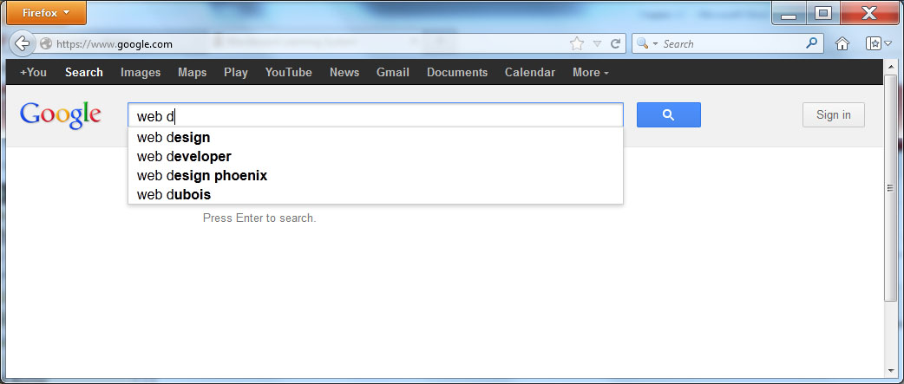
AJAX
AJAX provides a way for JavaScript to send and receive data to and from a server. A good example of the use of AJAX is the Google search engine. When you use Google, the page provides you with suggested queries as you type. As it turns out, each time you type a letter, the site uses AJAX to send your current text to the server, which in turn, sends back the recommended queries. The process is that fast!

Slide 4
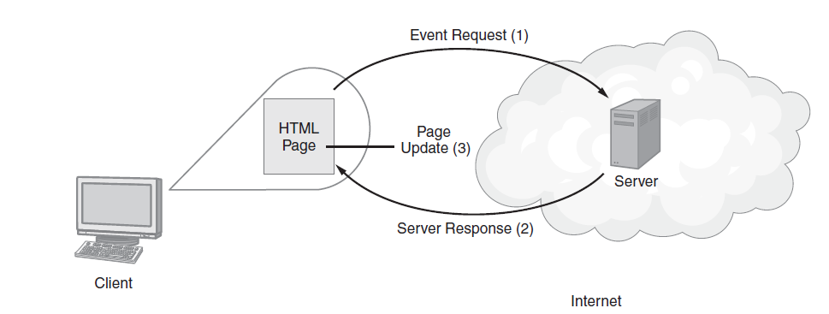
The Three-Step AJAX Process

Slide 5
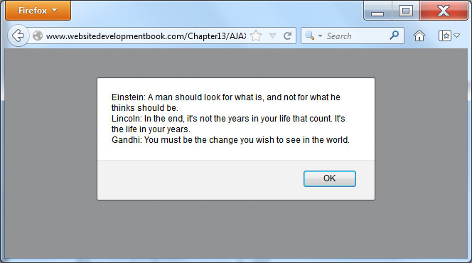
XMLHTTPREQUEST
<!DOCTYPE html> <html> <head> <script> varxmlhttp; function AJAXDemo() { xmlhttp = new XMLHttpRequest(); xmlhttp.onreadystatechange = HandleData; xmlhttp.open("GET","quotes.txt", true); xmlhttp.send(); } function HandleData() { if (xmlhttp.readyState==4 &&xmlhttp.status==200) { alert(xmlhttp.responseText); } } </script> </head> <body onload="AJAXDemo();"> </body> </html>

Slide 6
Asynchronous operations
The “A” in AJAX stands for Asynchronous. In general, what that means is that the browser will send a request to the server which in turn, will perform some processing, for which it will “get back” to the page in the future. When we perform asynchronous operations, we do not know how long the operation will take or when the server will get back.
In other words, the browser sends a request to the server and the then resumes whatever it was doing. When the server response comes back, the browser will stop what it is doing and will process the response. For this process to work, the browser defines a JavaScript function, called a “callback function,” which the browser will execute when the server response comes in.

Slide 7
Getting information from a script
<!DOCTYPE html> <html> <head> <script> varxmlhttp; function AJAXDemo() { xmlhttp = new XMLHttpRequest(); xmlhttp.onreadystatechange = HandleData; xmlhttp.open("GET","GetTime.php", true); xmlhttp.send(); } function HandleData() { if (xmlhttp.readyState==4 &&xmlhttp.status==200) { alert(xmlhttp.responseText); } } </script> </head> <body onload="AJAXDemo();"> </body> </html>

Slide 8
The PHP script
<?php $my_t=getdate(date("U")); print("$my_t[hours]:$my_t[minutes]"); ?>

Slide 9
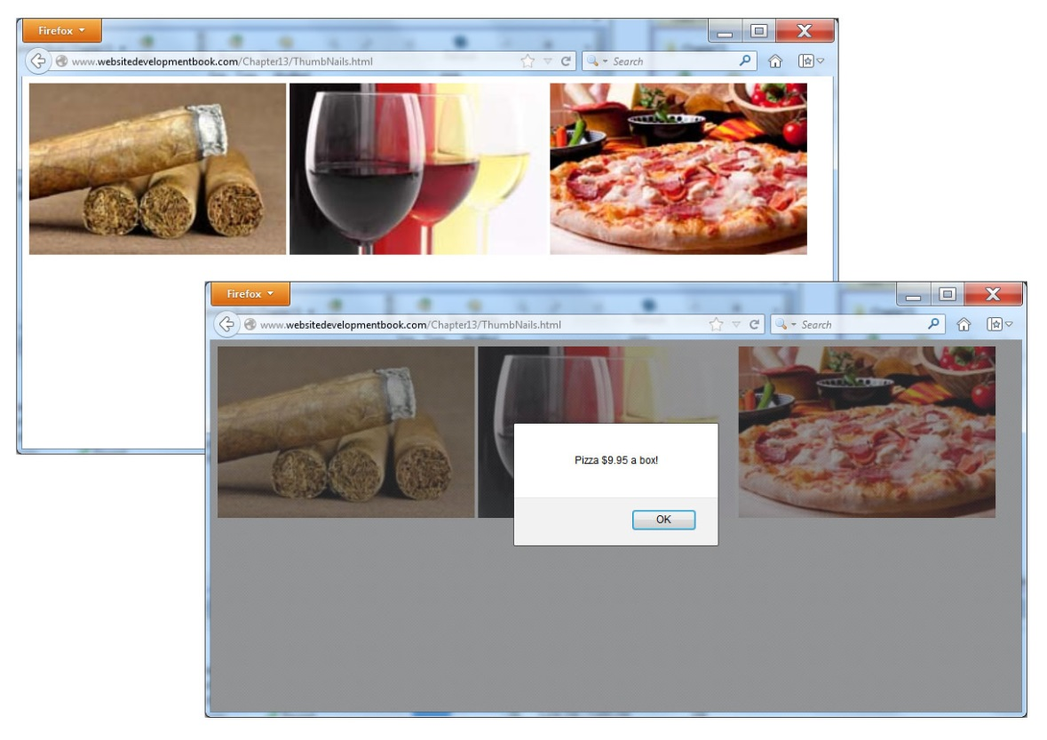
Mouseover events driving ajax requests
<!DOCTYPE html> <html> <head> <script> var xmlhttp; function AJAXData(DataRequest) { xmlhttp = new XMLHttpRequest(); xmlhttp.onreadystatechange = HandleData; xmlhttp.open("GET",DataRequest, true); xmlhttp.send(); } function HandleData() { if (xmlhttp.readyState==4 && xmlhttp.status==200) { alert(xmlhttp.responseText); } } </script> </head> <body> <img src="cigar.jpg" width="300" height="200" onmouseover="AJAXData('cigars.txt');"/> <img src="wine.jpg" width="300" height="200" onmouseover="AJAXData('wine.txt');"/> <img src="pizza.jpg" width="300" height="200" onmouseover="AJAXData('pizza.txt');"/> </body> </html>

Slide 10
Submitting data to a remote script
<!DOCTYPE html> <html> <head> <script> varxmlhttp; function EchoUppercase(DataString) { xmlhttp = new XMLHttpRequest(); xmlhttp.onreadystatechange = HandleData; xmlhttp.open("GET","Echo.php?src="+DataString, true); xmlhttp.send(); } function HandleData() { if (xmlhttp.readyState==4 &&xmlhttp.status==200) { alert(xmlhttp.responseText); } } </script> </head> <body> Type text: <input id="UserInput" type="text" /> <button onclick="EchoUppercase(document.getElementById('UserInput').value);">Click Here</button> </body> </html>

Slide 11
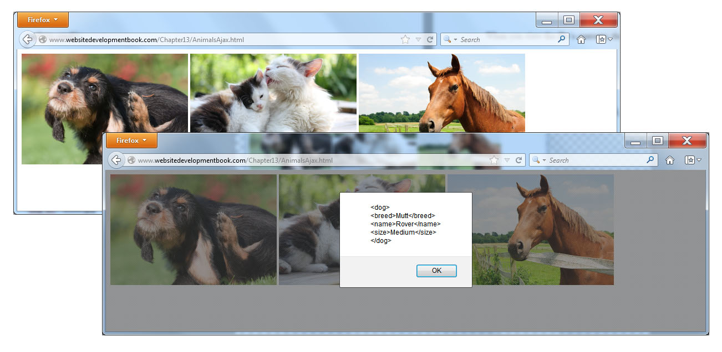
Getting XML data
<!DOCTYPE html> <html> <head> <script> varxmlhttp; function GetXMLData(DataString) { xmlhttp = new XMLHttpRequest(); xmlhttp.onreadystatechange = HandleData; xmlhttp.open("GET",DataString, true); xmlhttp.send(); } function HandleData() { if (xmlhttp.readyState==4 &&xmlhttp.status==200) { varxmlDoc = xmlhttp.responseText; alert(xmlDoc); } } </script> </head> <body> <imgsrc="dog.jpg" width="300" height="200" onclick="GetXMLData('dogs.xml');"/> <imgsrc="cat.jpg" width="300" height="200" onclick="GetXMLData('cats.xml');"/> <imgsrc="horse.jpg" width="300" height="200" onclick="GetXMLData('horses.xml');"/> </body> </html> </code>

Slide 12
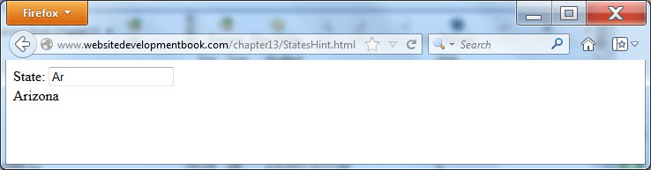
Real world: states hint
<!DOCTYPE html> <html> <head> <script> varxmlhttp; function GetState(DataString) { xmlhttp = new XMLHttpRequest(); xmlhttp.onreadystatechange = HandleData; xmlhttp.open("GET","State.php?src="+DataString, true); xmlhttp.send(); } function HandleData() { if (xmlhttp.readyState==4 &&xmlhttp.status==200) { document.getElementById('hint').innerHTML = xmlhttp.responseText; } } </script> </head> <body> State: <input id="UserInput" type="text" onkeyup="GetState(getElementById('UserInput').value);" /> <div id="hint"></div> </body> </html>

Slide 13
Real world: simple php script
<?php $str = strtoupper($_GET["src"]); if ($str === '') echo ''; elseif (strpos('ARIZONA', $str) === 0) echo 'Arizona'; elseif (strpos('ALABAMA', $str) === 0) echo 'Alabama'; elseif (strpos('ARKANSAS', $str) === 0) echo 'Arkansas'; elseif (strpos('CALIFORNIA', $str) === 0) echo 'California'; elseif (strpos('NEW YORK', $str) === 0) echo 'New York'; else echo ''; ?>

Slide 14
Summary
To improve web-page processing capabilities and functionality, developers can take advantage of the fact that JavaScript can send data and request content to or from a remote server.
Asynchronous JavaScript and XML, or AJAX, is a technique that developers can use to perform JavaScript-based interactions with a server.

